Slide 1

Team Details
Team name: Forge Breakers
Team leader name: Aryan Shukla
Problem Statement: AI for Intellectual Property Protection

Slide 2

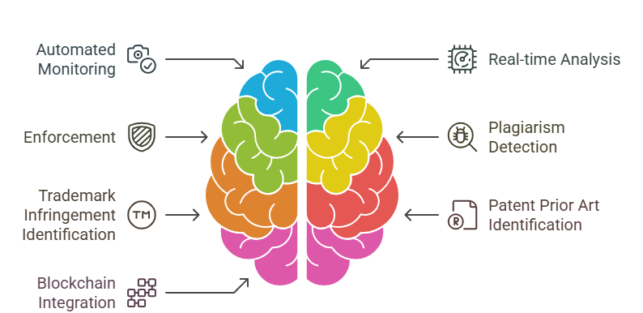
Brief about the Solution
AI enhances intellectual property (IP) protection through automated monitoring, real-time analysis, and enforcement. AI-powered tools detect unauthorized use of copyrighted content, trademarks, and patents by scanning digital platforms.
Machine learning identifies plagiarism, trademark infringements, and prior art for patents. AI integrated with blockchain ensures secure ownership records, while AI-driven legal assistants streamline compliance and enforcement.

Slide 3
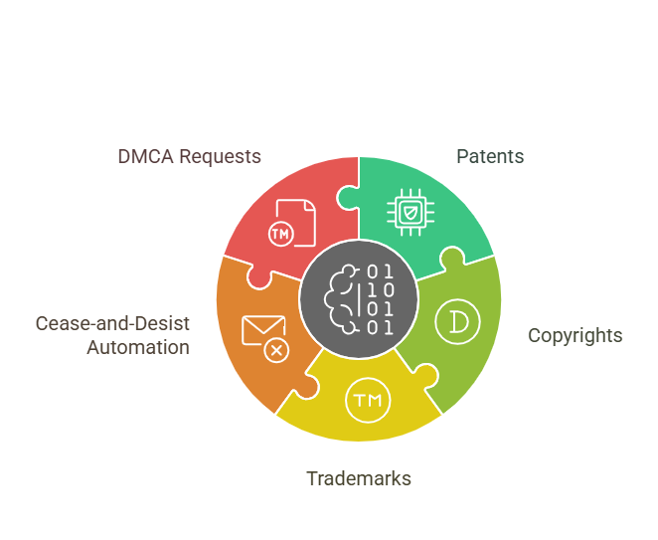
Opportunities How different is it from any of the other existing ideas? 1.Our AI system could integrate patents, copyrights, and trademarks in a unified framework, allowing for cross-domain protection. 2.Our AI could automate sending cease-and-desist notices, DMCA takedown requests, or legal alerts, reducing human effort and response time. How will it be able to solve the problem? AI enhances intellectual property protection by automating the detection of copyright,
trademark, and patent violations through machine learning and web monitoring.
USP of the proposed solution?
Automated & Scalable Protection
Efficient Legal & Ownership Management

Slide 4
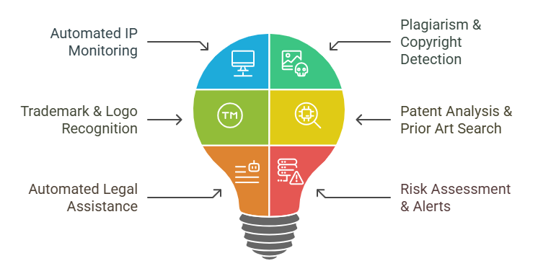
List of features offered by the solution Automated IP Monitoring: AI-driven web crawlers continuously scan online platforms for copyright, trademark, and patent violations. Plagiarism & Copyright Detection: AI analyzes text, images, and videos to detect unauthorized content usage in real time. Trademark & Logo Recognition: Deep learning models compare brand elements to identify potential trademark infringements. Patent Analysis & Prior Art Search: AI assists in patent examination, novelty verification, and prior art detection. Automated Legal Assistance: AI chatbots help draft, review, and manage IP-related
Legal documents.
Risk Assessment & Alerts: AI evaluates infringement risks and sends proactive alerts to IP owners.

Slide 5
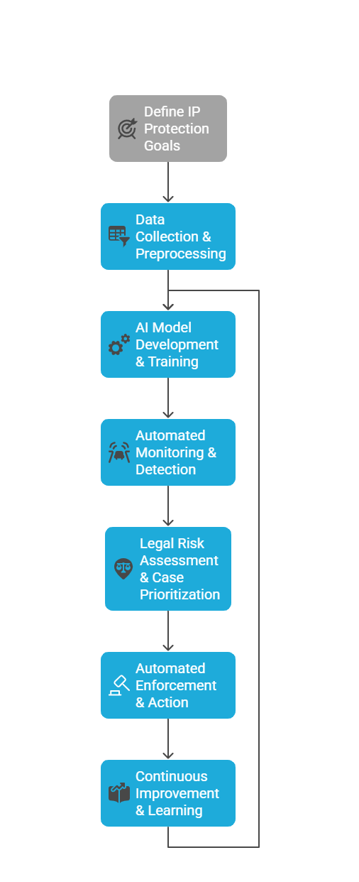
Process flow diagram or Use-case diagram

Slide 6
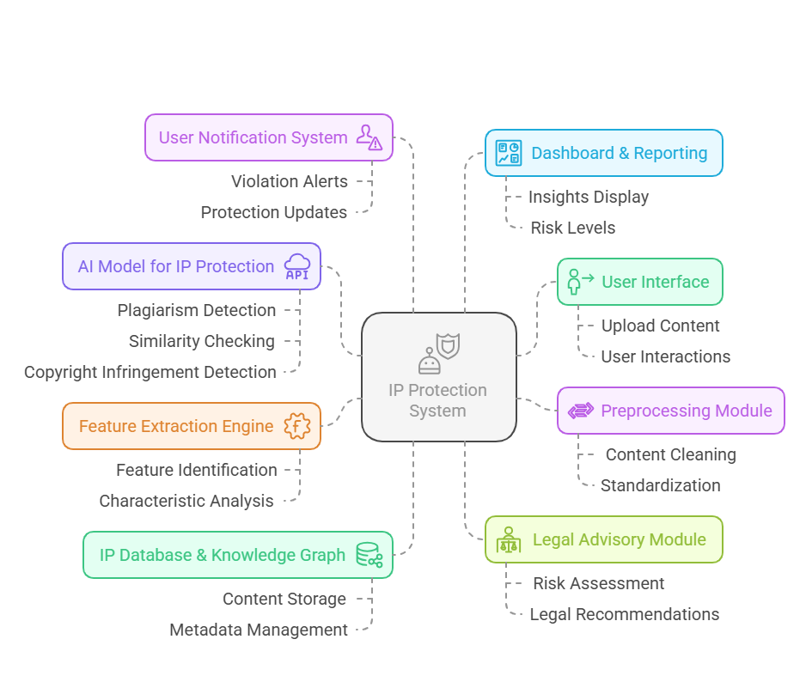
Architecture diagram of the proposed solution

Slide 7
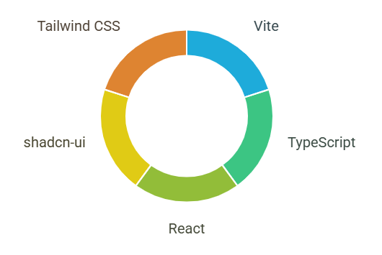
Technologies used in the solution
Vite: A fast build tool for modern web development, optimizing performance with instant hot module replacement.
TypeScript: A superset of JavaScript that adds static typing, improving code reliability and developer experience.
React: A JavaScript library for building interactive UI components with a component-based architecture.
shadcn-ui: A collection of accessible and customizable React components built using Radix UI and Tailwind CSS.
Tailwind CS*: A utility-first CSS framework that allows rapid styling using predefined classes.

Slide 8
Provide links to your:
1.GitHub Public Repository
https://github.com/Aryanshukla578/protectopia-website.git
2. Demo Video Link (3 Minutes)
https://drive.google.com/file/d/1-BPWblhFFcw-qntgXQRx4zel3sNGUgSE/view?usp=drivesdk

Slide 9


